Slide 1

tasktrackr A collaborative task management solution.
Presented by Jada Towner
Prof. Jafrina Jabin
INFO C451
11/9/2024
Notes:
Hello, everyone! Today, I'm presenting TaskTrackr, a collaborative task management solution designed to enhance productivity and organization within teams. My name is Jada Towner, and I developed this project as part of INFO C451 under the guidance of Professor Jafrina Jabin. Let’s dive into how TaskTrackr addresses common task management challenges.

Slide 2

Project Introduction
tasktrackr is a collaborative tool designed to streamline task management for teams, helping users stay organized, prioritize tasks, and collaborate effectively.
Problem Statement: Teams often miss deadlines due to poor task organization and lack of communication.
Solution: Offers prioritized task creation, role-based access, real-time collaboration, and analytics.
Notes:
TaskTrackr was created to solve a recurring issue in team environments: poor task organization and communication can lead to missed deadlines and reduced productivity. TaskTrackr helps teams streamline task management by providing prioritized task creation, role-based access, real-time collaboration, and analytics, all geared towards helping users stay organized and on track.

Slide 3

Target Audience
Who: Project managers, team members, freelancers.
Needs:
Managers: Insights into team progress.
Team Members: Organized task list, notifications.
Freelancers: Clear task updates across projects.
Key Use Cases: Assigning tasks, setting priorities, improving communication.
Notes:
The primary users of TaskTrackr are project managers, team members, and freelancers. Each group has unique needs:
Managers require insights into team progress to make informed decisions.
Team members need a structured way to keep track of tasks and deadlines.
Freelancers benefit from updates on task status across multiple projects. Key use cases include assigning tasks, setting priorities, and improving team communication to ensure that everyone is aligned.

Slide 4

Feature List
Task Management: Create, assign, prioritize tasks.
Role-Based Access: Manager and team views tailored for security.
Collaboration: Chat and notifications streamline team updates.
Dashboard: Visualize productivity and task status.
Calendar: Organizes deadlines for easy tracking.
This Photo by Unknown Author is licensed under CC BY-NC
Notes:
TaskTrackr’s core features cater to efficient team management:
Task Management: Users can create, assign, and prioritize tasks.
Role-Based Access: Managers and team members have different views, ensuring security and tailored functionality.
Collaboration: Chat and notifications keep everyone in sync with task updates.
Dashboard: Offers visual insights into productivity and task progress.
Calendar: Deadlines and milestones are organized in a calendar view, making it easy to track upcoming tasks.

Slide 5
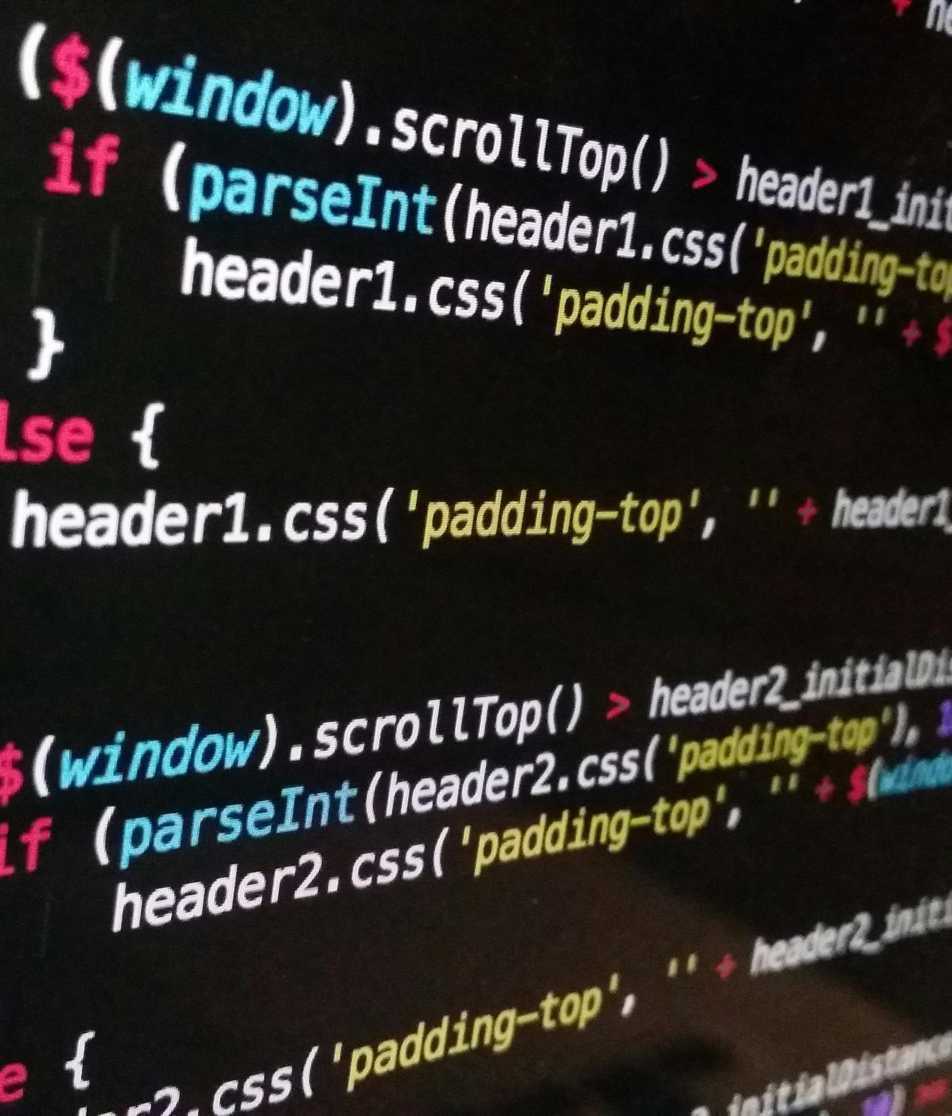
Roadmap for the Demo
Frontend: React for UI.
Backend: Node.js and Express for logic.
Database: MongoDB stores tasks, users.
Data Flow: Frontend requests, backend processes, database stores securely.
Notes:
TaskTrackr is built using a full-stack architecture:
The frontend is built with React to provide a dynamic and interactive user interface.
Backend logic is handled by Node.js and Express, ensuring smooth data processing.
MongoDB stores all task and user data securely. Data flows seamlessly from the user’s actions in the frontend to the backend and database, ensuring data integrity and security at every stage.

Slide 6

Future Development Plans
New Features:
Dependencies: Link tasks in sequence.
Subtasks: Break down larger tasks.
Enhanced Analytics: Deeper productivity insights.
Customizable Dashboard: Personalize metrics.
Notes:
Looking forward, I have some exciting development plans for TaskTrackr:
Task Dependencies: This feature will allow users to link tasks, creating a logical order for task completion.
Subtasks: Breaking down larger tasks into subtasks for better manageability.
Enhanced Analytics: Adding deeper insights into productivity trends over time.
Customizable Dashboard: Users will be able to personalize their dashboard to prioritize the information they find most useful.

Slide 7

Conclusion and Key Takeaways
Solution: Simplifies team collaboration and task management.
Effectiveness: Real-time updates, analytics support productivity.
User-Friendly: Easy for all roles to adopt and use.
This Photo by Unknown Author is licensed under CC BY-SA
Notes:
In summary, TaskTrackr simplifies team collaboration and task management. The real-time updates and analytics make it an effective tool to support productivity. It’s user-friendly and accessible, ensuring that all team members can adopt it easily and use it to its full potential. TaskTrackr helps teams stay organized, prioritize tasks, and communicate effectively, reducing the risk of missed deadlines.

Slide 8
Thank you!
Email: jadatown@iu.edu
Feedback Welcome!
Notes:
Thank you for your attention! I’m happy to answer any questions or hear feedback on TaskTrackr. If you’d like to connect or follow my work, feel free to reach out via email at jadatown@iu.edu. Your insights and feedback are always welcome!

